Slide 1

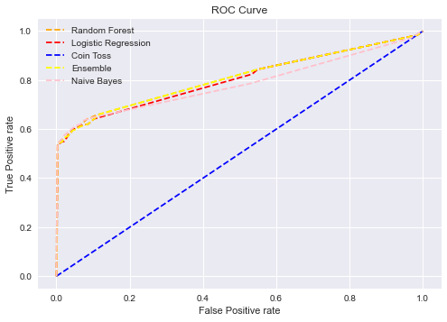


Building an ensemble of 3 different models to predict who has Covid-19 based on simple survey results.
https://github.com/nomopix/cs-ai-l7-oct-hackathon
BACKGROUND
In a 2-day hackathon, as part of our learning in AI Level 7 apprenticeship, we have worked on building a machine learning model to predict COVID-19 test results based on reported symptoms, inspired by this paper publication:
https://www.nature.com/articles/s41746-020-00372-6
AIM
COVID-19 is stretching our healthcare resources, and we are aiming to build a model that provides insight around how to better utilize these resources.
APPROACH
Building a machine learning model that predicts COVID-19 cases from simple features accessed by completed surveys (containing 8 True/False questions).
Our team of 6 split into 3 pairs for increased efficiency, each pair focusing on a different machine learning model before creating an ensemble together.
DATA PREPROCESSING
Converted odd strings of numbers to integers
Converted "None" values to integer 2
One-hot-encoded the data
MODELS
Logistic Regression
Decision Tree
Random Forest
K-Nearest-Neighbours (KNN)
Ensemble (voting – majority vote wins)
RESULTS
Encoding "none" would provide better results than removing them
Ensemble: Depending on the selection the outcome would be worst as other models
ROC scores:
Ensemble ROC Score:
(RF, LR, NB) 0.813
(RF,LR, KNN) 0.812
Naïve Bayes ROC Score: 0.812
Random Forest ROC Score: 0.808
Logistic Regression ROC Score: 0.802
Decision Tree ROC Score: 0.785
KNN ROC Score: 0.783
Random Guessing ROC Score: 0.500
BEST ROC SCORE
Ensemble: RF, LR, NB -> 0.813
OUR TEAM
1. Dominic van der Pas
2. Gian Giacomo Valentini
3. Yu Bian
4. Sohail Mahmood
5. Stuart Jennings
6. Noemi Moreno Fabelo
Data Cleansing
ROC Score (Validation Dataset)
Hyperparameter Optimisation
Creating Ensemble
One Hot Encoding
ROC Score (Test Dataset)
Jupyter Notebook Script
Referenced academic paper
https://github.com/nomopix/cs-ai-l7-oct-hackathon
https://www.nature.com/articles/s41746-020-00372-6
Notes:
Dominic: Approach + method + preprocessing + 3 models.
Gian -
1. Logistical Regression – GridSeachCV, ROC Scores
2. Decision Tree & Random Forest
3. KNN
4. Ensembling of multiple models
Yu -
What we've learned:
1) try other combinations of ensemble where models may not have correlations > KNN may not be suitable for big datasets, Naive Bayes may have been a better choice
2) etc..
Sohail -
Graph, results and numbers
Stuart -
Z: Conclusions, learning
Best Outcome: Ensemble with Naïve Bayes, Random Forest and Logistic Regression
Limitations/Next steps: 1) this focuses on Israel, would the model perform similarly with other countru's data?
2) Include vaccinations
3) Length of contact with people
4) Taste and smell
5) etc...
6) Reduce Dimensionality
7) Etc...
Any Questions?
ALL: QA

